Slide 1
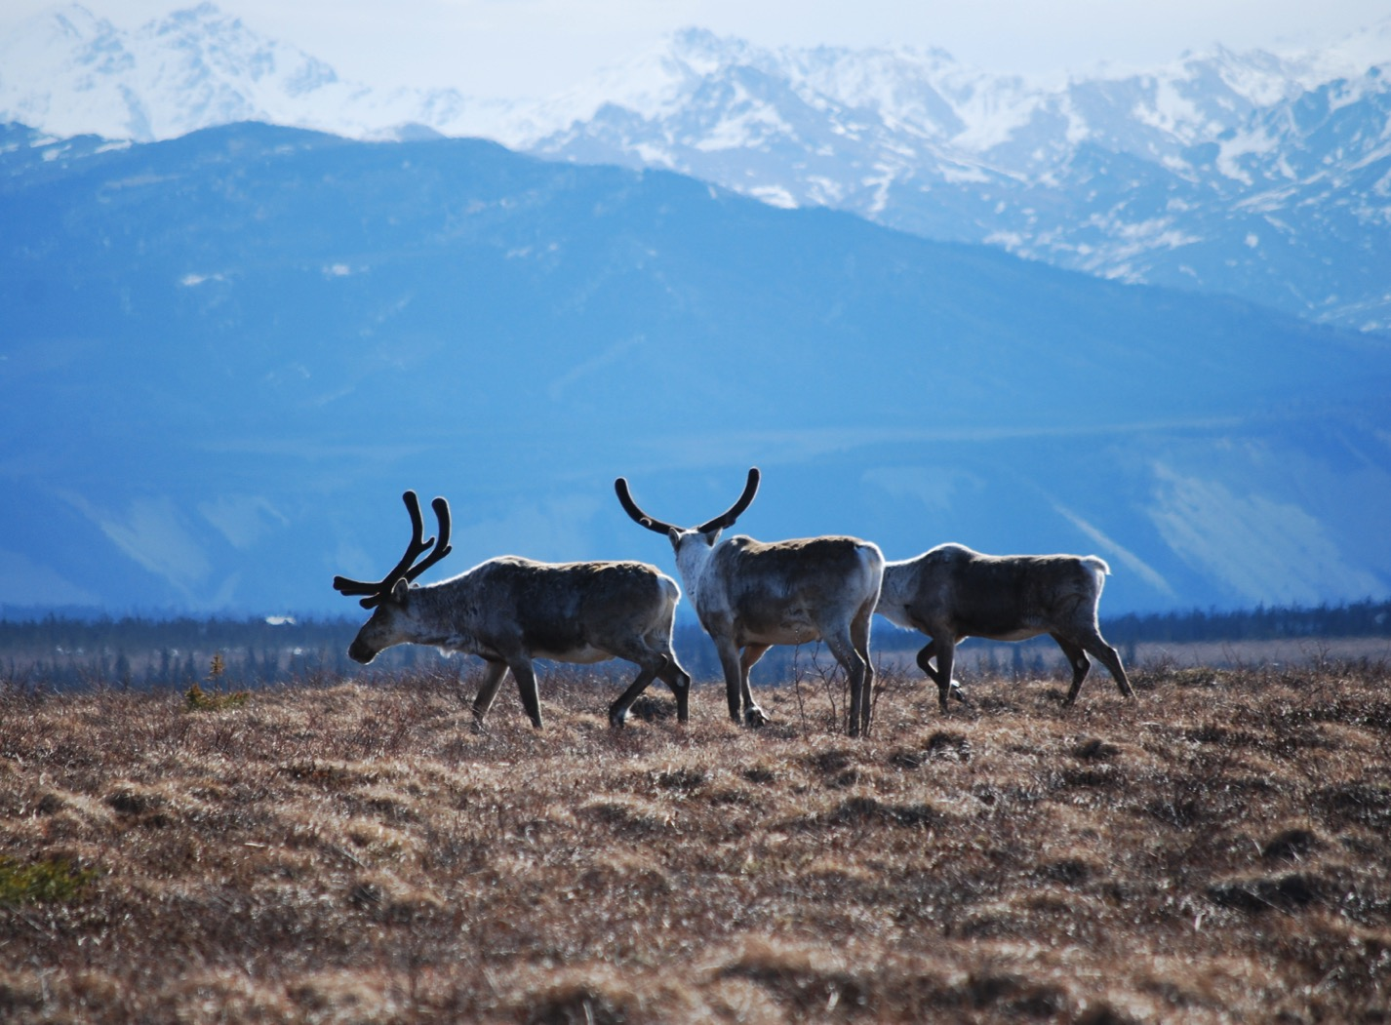
Arctic Boreal Vulnerability Experiment (ABoVE)
2017 ABoVE Airborne Campaign
29 May 2017 (DOY 149)
AirMOSS: Seward Peninsula
Charles Miller, Deputy Science Lead
Jet Propulsion Laboratory, California Institute of Technology
and the ABoVE Science Team For Hank Margolis, Eric Kasichke, Bruce Tagg
NASA HQ
May 2017

Slide 2
29 May 2017/DOY 149 Seward Peninsula
Assets Deployed:
Fairbanks (PAFA) – AirMOSS (P-band SAR)/JSC G-III (N992NA)
Pilots: Tom “T-Rex” Ryan, Scott “Bonz” Reagan, Tom “Duster” Parent
Science Coordinator: N Pinto
Science Lead: M Moghaddam
Project Manager: Y Lou
Mechanics: Johnny Scott, Jim Fennel
Operators: Phil Vaughn, Dave Elliot, Rocky Smith, Roger Chao, Joanne Shimada

Slide 3
29 May 2017/DOY 149 Seward Peninsula
Daily Summary:
Science Flight
All planned lines acquired successfully
AIRCRAFT: Aircraft took a lightning hit at 9000' today and the outboard static wick on the left horizontal stabilizer was missing when we landed. No other visible or electronic damage that we noticed.
PPA: No issues with the PPA today, it continues to work well. We were able to get all lines complete with no repeats.
RADAR: No radar discrepancies.

Slide 4
29 May 2017/DOY 149 72-Hour Look Ahead
All plans weather dependent
NOTE: Lightning strike experienced towards the end of the flight has placed an indefinite delay in the upcoming schedule.
Tuesday 30 May 2017 (DOY 150):
Repairs
Wednesday 31 May 2017 (DOY 151):
Repairs
Thursday 1 June 2017 (DOY 152):
Repairs
Friday 2 June 2017 (DOY 153):
TBD

Slide 5
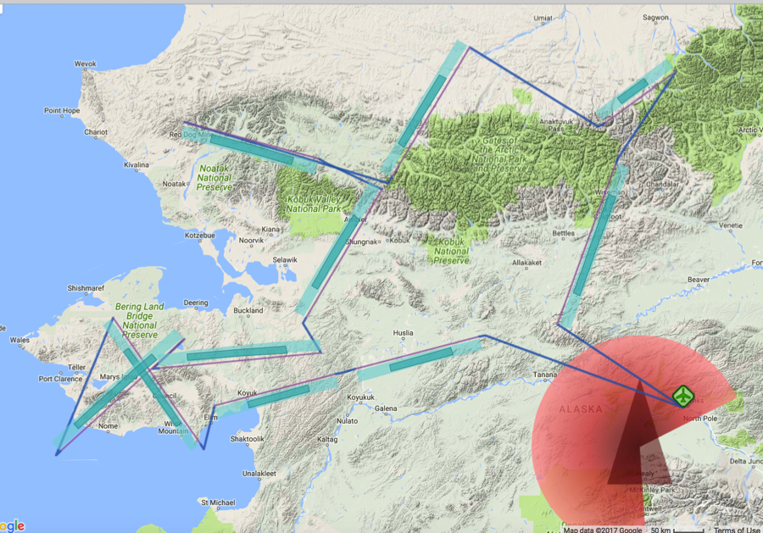
29 May 2017/DOY 149 Seward Peninsula
Flight Plan 1116 v02: Fairbanks AK (PAFA) – PAFA
https://uavsar.jpl.nasa.gov/cgi-bin/report.pl?planID=PLAN_1116_v02#flightPlan
Data Acquisitions:
Line 1, ID 25507: Acquired 5/27/17
Line 2, ID 25508: Acquired 5/27/17
Line 3, ID 32510: Council
Line 4, ID 04803: Teller
Line 5, ID 08509: Kougarok
Line 6, ID 03106: Acquired 5/27/17
Line 7, ID 28507: Noatak
Line 8, ID 03107: Ivotuk
Line 9, ID 05403: Toolik
Line 10, ID 20007: Acquired 5/27/17
Line 11, ID 21507: Yukon Flats 1
Line 12, ID 04706: Yukon Flats 3
Line 13, ID 21608: Yukon Flats 2
P-band keep-out zone shown in RED
(centered on Clear, AK: 64.29 N, 149.19 W)
05403
03107
28507
03106
20007
21507
04706
21608
08509
04803
25507
25508
32510
5/29/17 flight plan & acquisition segments
Notes:
4 lines from this plan acquired on 5/26: 1/25507, 2/25508, 6/03106, and 10/20007
Adding 3 lines in the Yukon Flats from Flight Plan 1117 v02: 21507, 04706, and 21608

Slide 6
29 May 2017/DOY 149 Seward Peninsula
Pilot’s 5/29/17 flight plan & acquisition segments
Tom “T-Rex” Ryan, PIC N992NA
Notes:
Pilot’s plan for 5/29/17 – removes 4 lines acquired on 5/27, and adds the 3 Yukon Flats lines from Plan 1117 v02

Slide 7
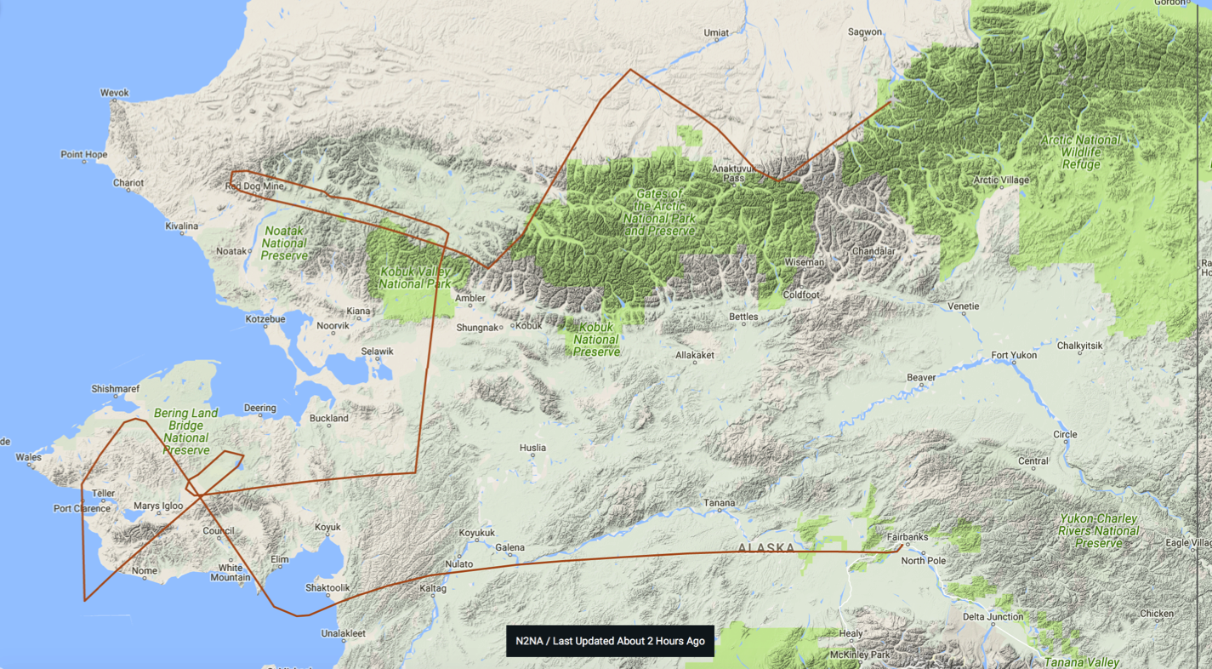
29 May 2017/DOY 149 Seward Peninsula
Actual Flight Lines
05403
03107
28507
21507
21608
04706
08509
04803
32510

Slide 8
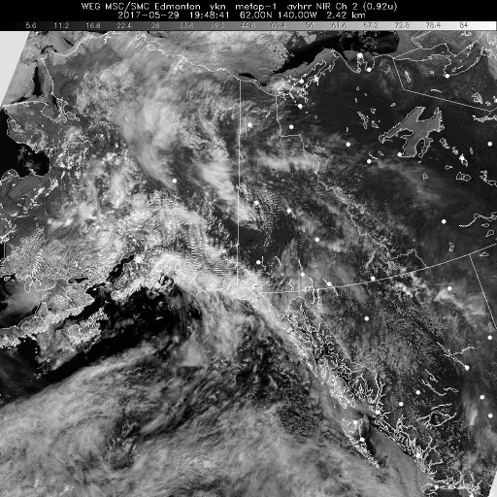
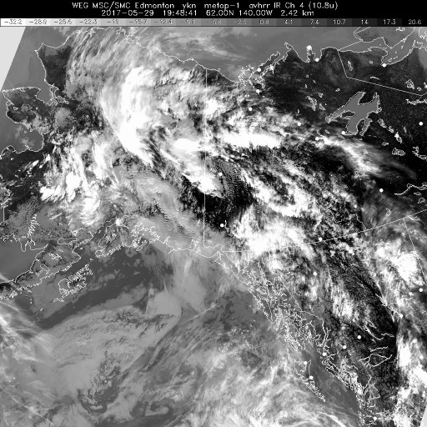
29 May 2017/DOY 149 Seward Peninsula
HRPT NIR 1948Z
HRPT IR 1948Z
HRPT NIR (left) and IR (right) show partly cloudy over the Seward Peninsula and mostly cloudy elsewhere across Alaska

Slide 9
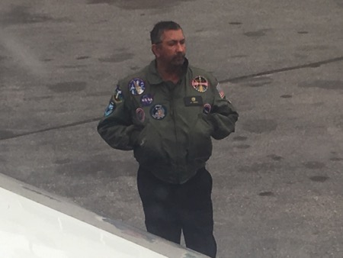
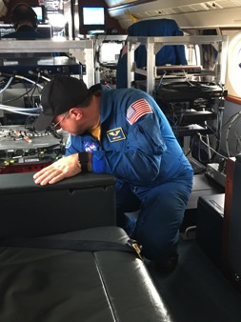
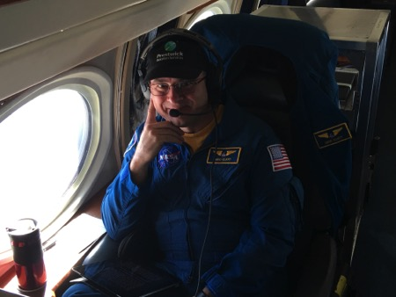
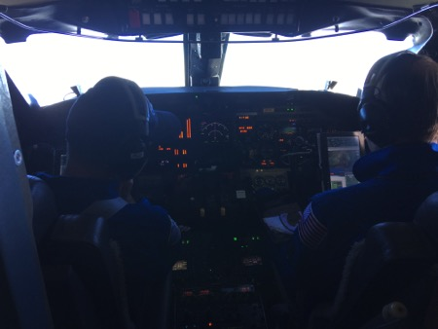
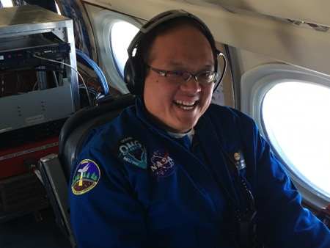
29 May 2017/DOY 149 Seward Peninsula
Stevens Village
Beaver
In-flight action

Slide 10
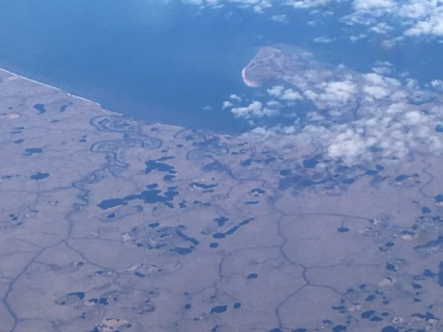
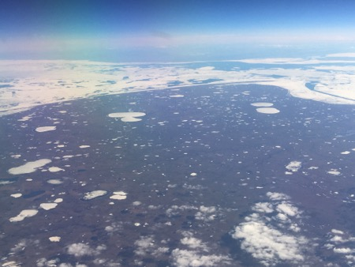
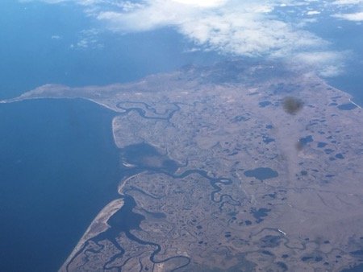
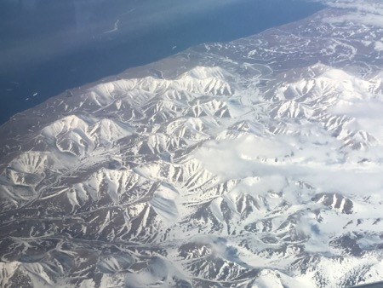
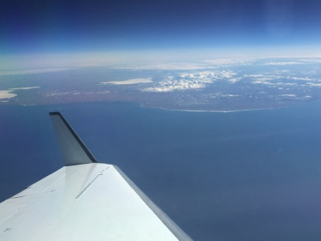
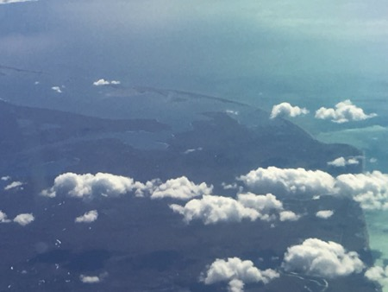
29 May 2017/DOY 149 Seward Peninsula
Stevens Village
Beaver
Seward Peninsula coastal sights

Slide 11
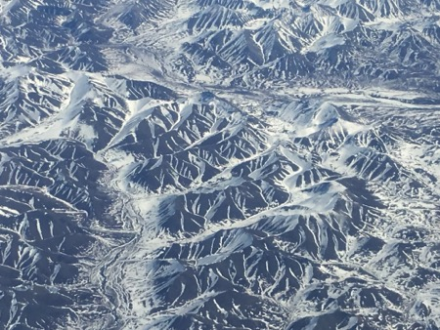
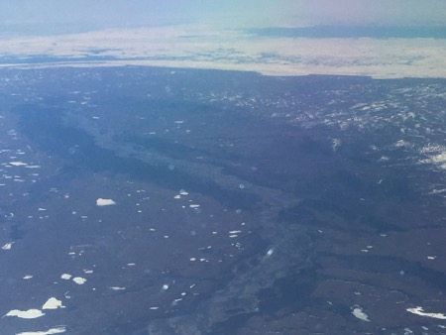
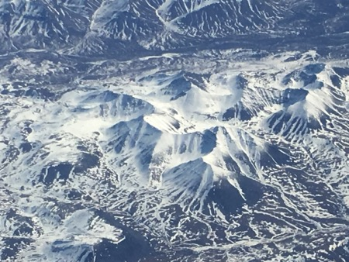
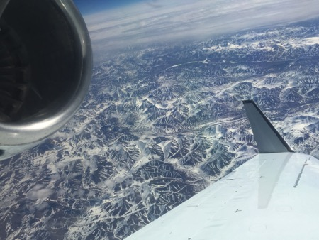
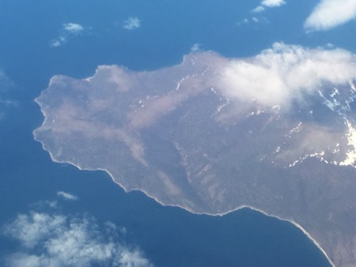
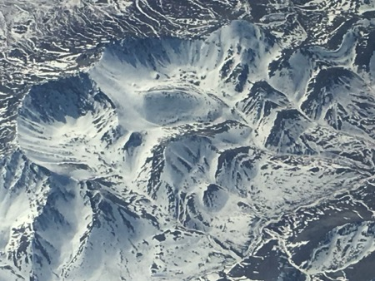
29 May 2017/DOY 149 Seward Peninsula
Stevens Village
Beaver
Selawik, Noatak, and Brooks Range

Slide 12
29 May 2017/DOY 149 Seward Peninsula
A
B
C
AirMOSS Quick-look products
A. Line 1, ID 32510: Council
B. Line 2, ID 04900: Teller
C. Line 3, ID 08509: Kougarok
These lines cover the 3 watersheds that are the focus of NGEE-Arctic activities in the Seward Peninsula. They will be a key contribution to the ABoVE – NGEE collaboration.
Cathy Wilson, Stan Wullschleger and other NGEE team members collected ground truth data during the overflights
Joanne Shimada, JPL

Slide 13
29 May 2017/DOY 149 Seward Peninsula
A
B
C
AirMOSS Quick-look products
A. Line 4, ID 28608: Noatak
B. Line 5, ID 03107: Ivotuk
C. Line 6, ID 05406: Toolik
The Noatak River is clearly observed in Line A. This line covers a number of burn areas where field data are available
Line B includes the flux tower @ Ivotuk
Line C includes the Toolik Lake Arctic LTER and adjacent research sites
Joanne Shimada, JPL

Slide 14
29 May 2017/DOY 149 Seward Peninsula
A
B
C
AirMOSS Quick-look products
A. Line 7, ID 21507: Yukon Flats 1
B. Line 8, ID 04706: Yukon Flats 3
C. Line 9, ID 21608: Yukon Flats 2
Joanne Shimada, JPL

Slide 15
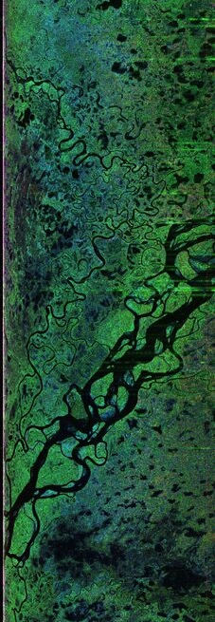
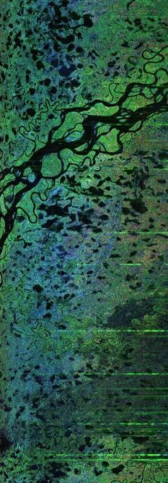
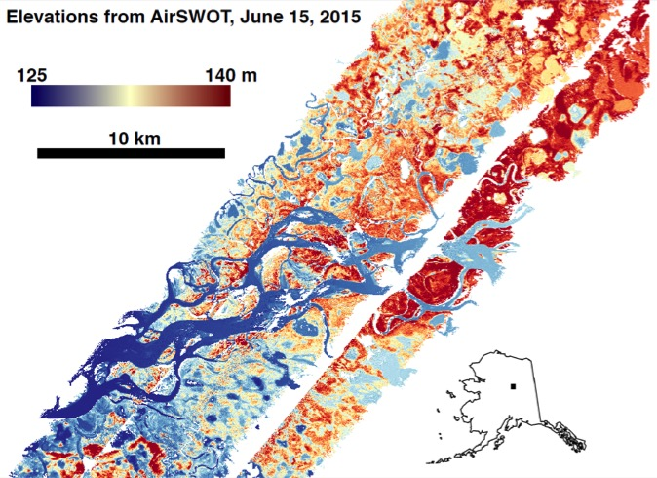
29 May 2017/DOY 149 Seward Peninsula
21608
21507
Details of overlapping AirMOSS swaths in the Yukon Flats capture the Yukon River and neighboring wetlands
This area be the target of dense Ka-band radar sampling by AirSWOT in July & August – see 2015 AirSWOT imagery above

